Slide 1
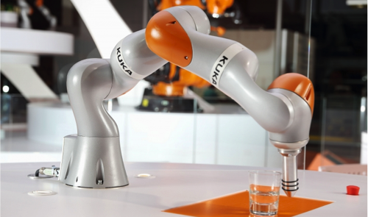

sampling-based algorithms and control methods for SURGICAL TASKS
Akhil Bandamidapalli – ME20B016
PRITHVI rAJ b - ME20B137

Slide 2
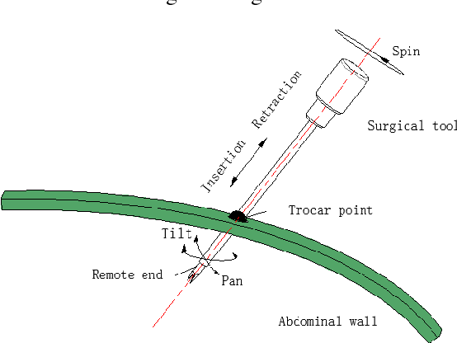
Project definition
AIM : Implement and compare different motion planning algorithms Kuka iiwa7 to perform certain surgical tasks,
We also aim to achieve,
Constraint adherence: To ensure the chosen algorithm considers constraints like obstacle avoidance and minimize motion in specific directions
Remote centre of motion: Establish a remote centre of motion in the algorithm, a critical aspect in robotic surgeries
Yun-ping, Zhu and Zhang Fan. “A Novel Remote Center-of Motion Parallel manipulator for Minimally Invasive Celiac Surgery.” (2015).

Slide 3
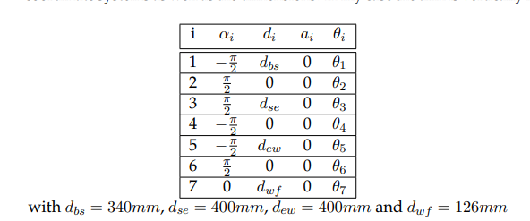
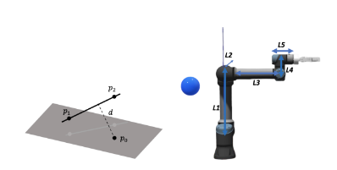
PROGRESS Till mIDterm
As per the timeline chart, we were able to implement joint control and RRT, RRT* algorithms for our use case.
Implemented on PyBullet as discrete collision checking was easier
Currently, we can plan paths from a random, collision-free start config to the required goal config.
Used collision checker based on distance from each link to obstacles

Slide 4
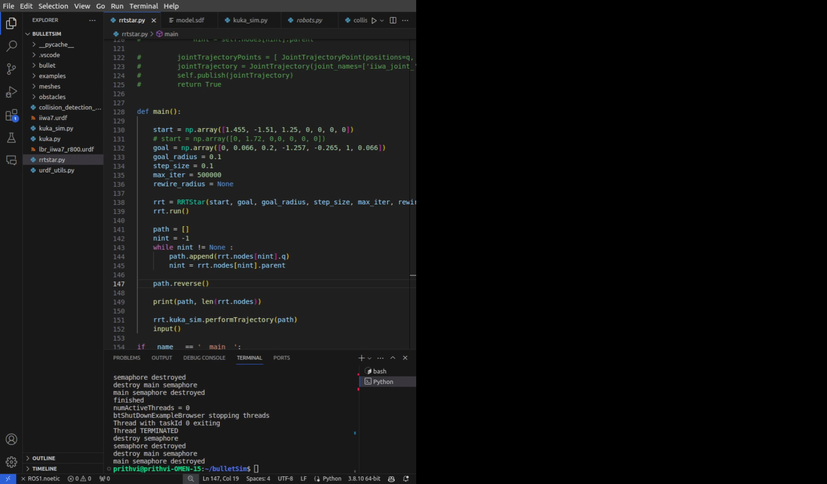
RRT DEMO VIDEO

Slide 5
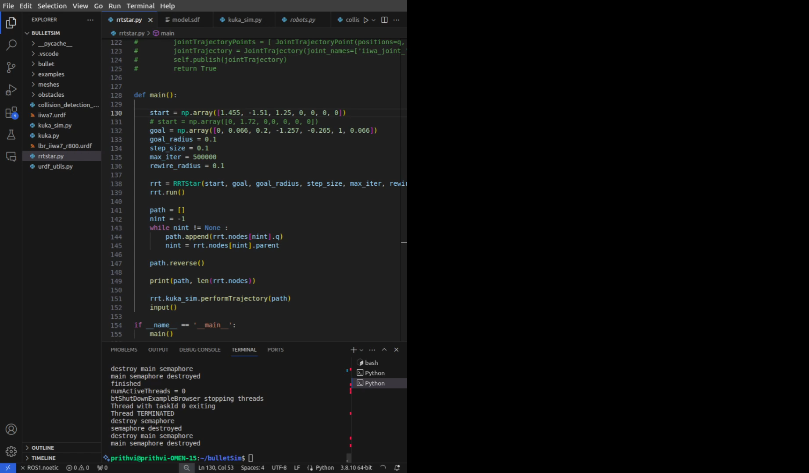
RRT* DEMO VIDEO

Slide 6
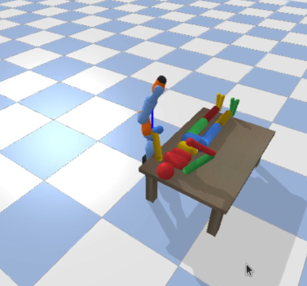
Inferences
We noticed the entire process takes 116 iterations
This was probably because of a more efficient goal bias given after every 100 iterations.
We also notice that the robot avoids the table and human arm during its motion, thereby validating our collision checkers.

Slide 7
MILESTONES AND TIMELINE
Environment setup on PyBullet,
Literature review
Algorithm implementation of RRT*, joint control
Simulation of Step 1 without constraints
Simulation of Step 1 with given constraints
Midterm Review
Implement path following
algorithms
Implement RCM constraints, test for basic cases
Simulation of Step 2
Endterm Review

Slide 8
REFERENCES
Yun-ping, Z., & Fan, Z. (2015). A Novel Remote Center-of Motion Parallel manipulator for Minimally Invasive Celiac Surgery.
M. Minelli and C. Secchi, "A Torque Controlled Approach for Virtual Remote Centre of Motion Implementation," 2022 IEEE/RSJ International Conference on Intelligent Robots and Systems (IROS), Kyoto, Japan, 2022, pp. 4949-4956, doi: 10.1109/IROS47612.2022.9981619.
Y. Zhang, Z. Qi and H. Zhang, "An Improved RRT* Algorithm Combining Motion Constraint and Artificial Potential Field for Robot-Assisted Flexible Needle Insertion in 3D Environment," 2021 3rd International Conference on Industrial Artificial Intelligence (IAI), Shenyang, China, 2021, pp. 1-6, doi: 10.1109/IAI53119.2021.9619224.
QUESTIONS?

